Slide 1



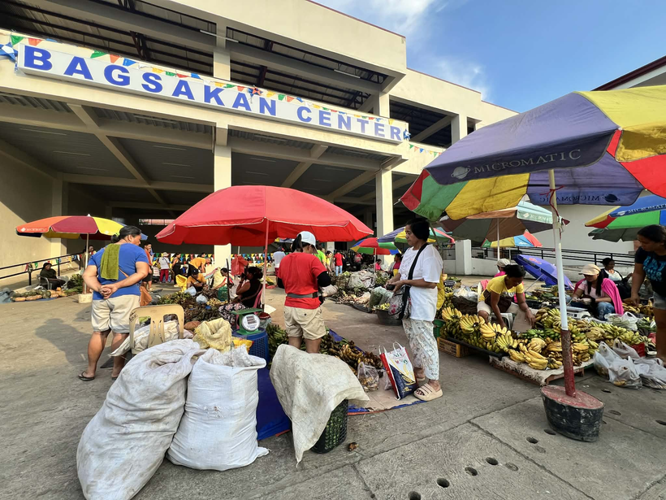
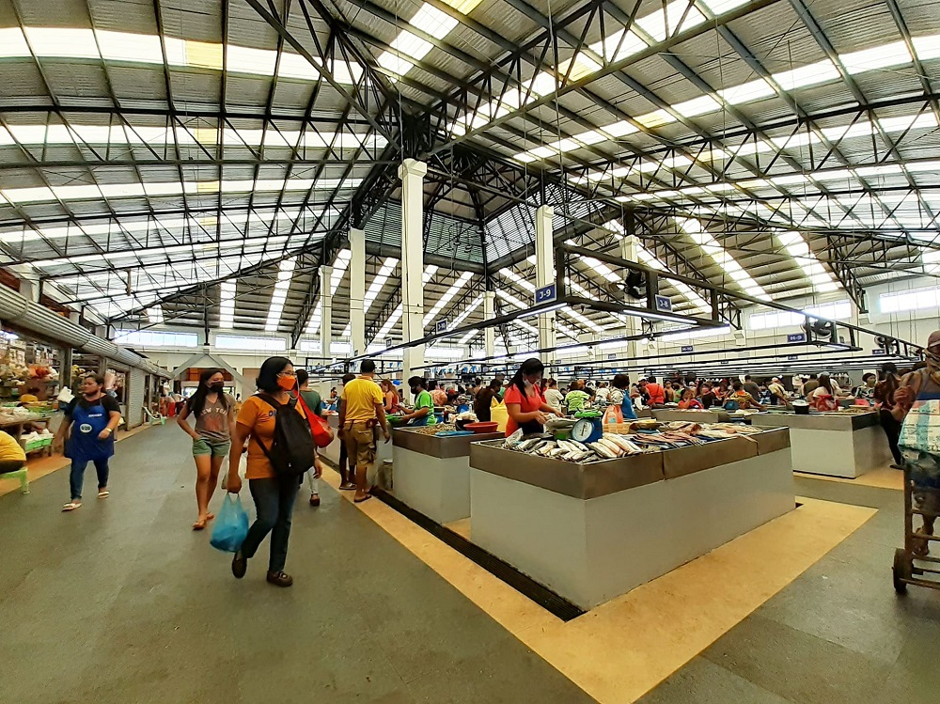


Habits of
Buying, Saving, & Living sustainably
Many Filipinos practice resourcefulness and avoid waste through simple habits of buying, saving, and living.
These everyday actions help us use what we have more wisely.
Presented by
Lor Frederick Aquino

Slide 2
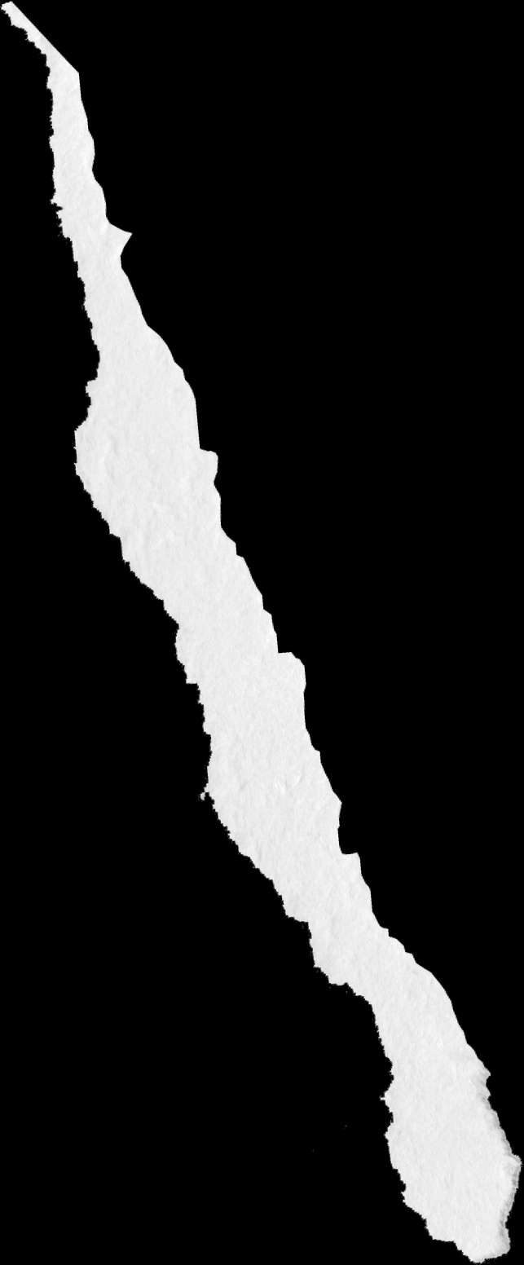

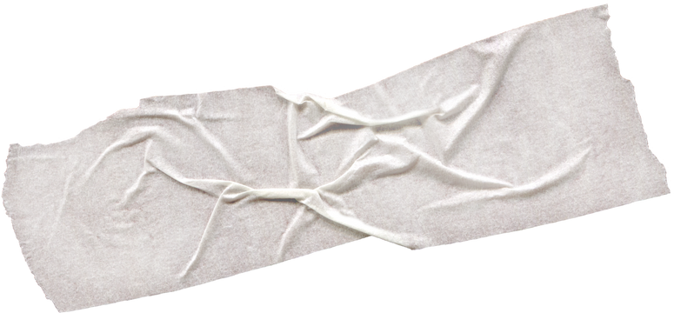
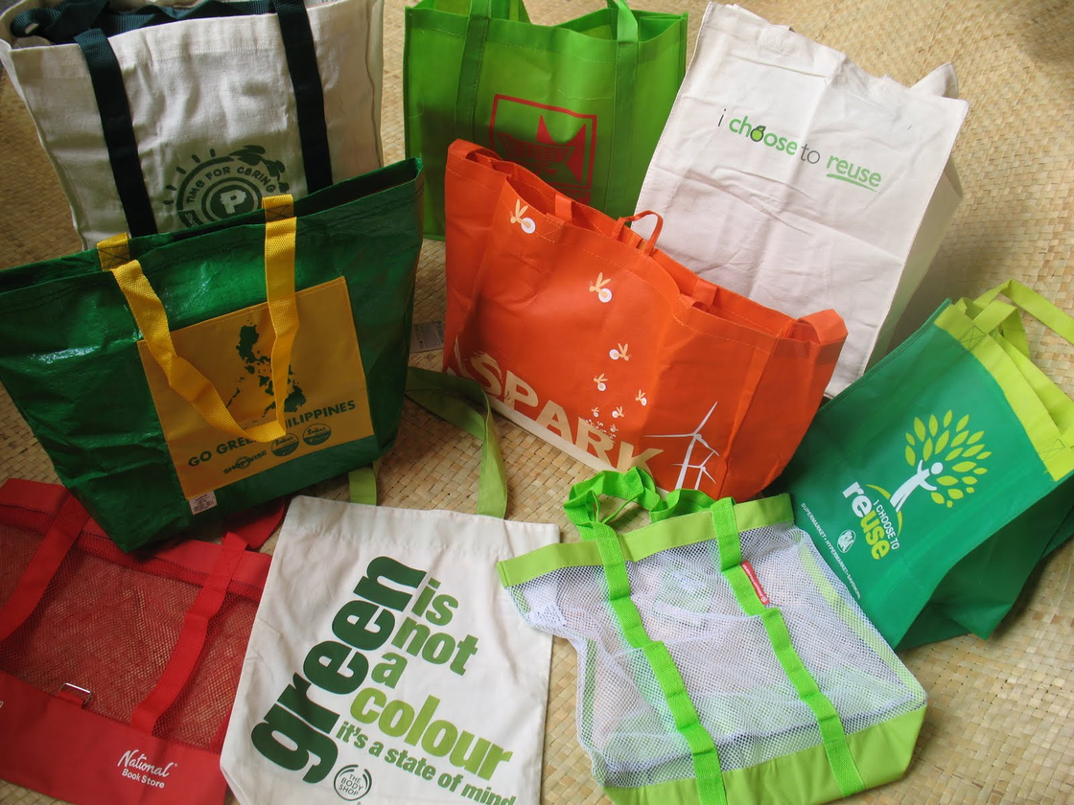
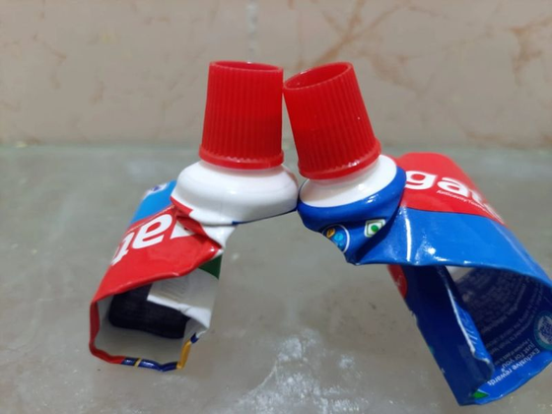
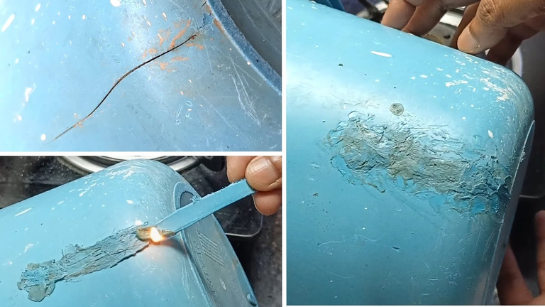
BUYING AND SAVING THE FILIPINO WAY
Sustainable practices we do at home:
Less plastic, fresh food, supports farmers
Sulit – maximizing the worth of what we buy (using every last drop)
Repairing cracked housewares instead of buying new ones

Slide 3
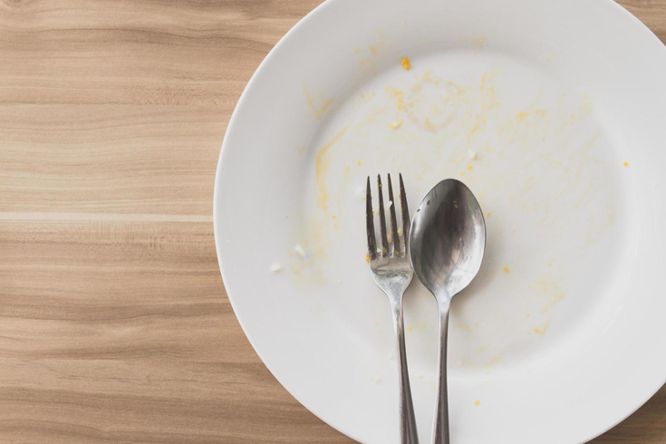
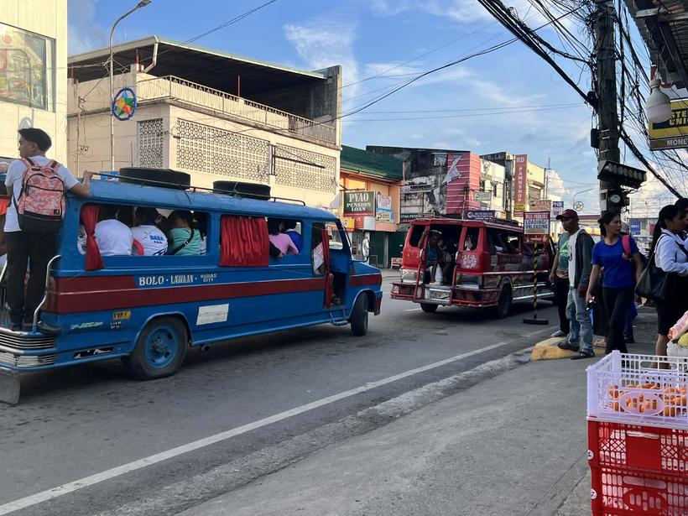
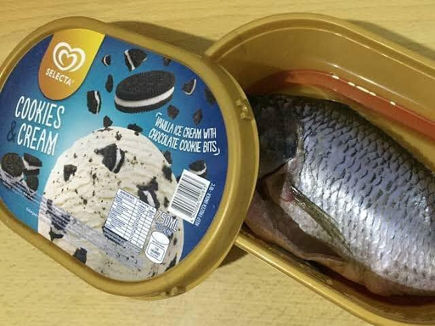
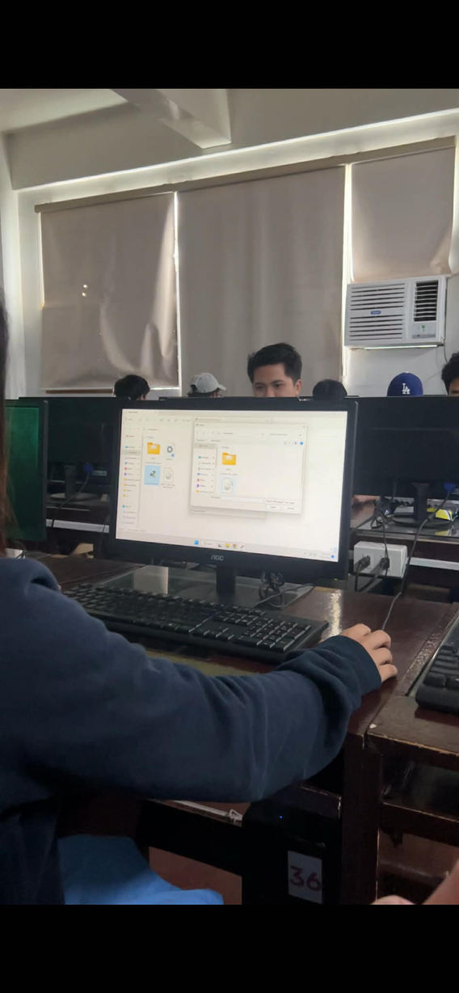
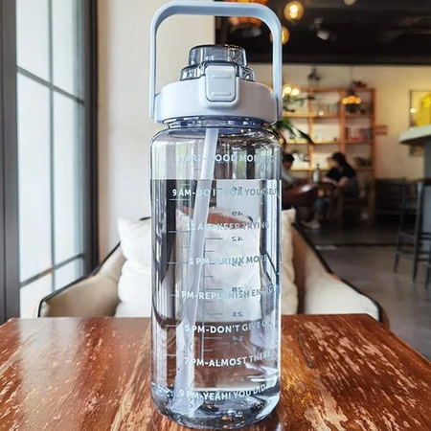
SIMPLE SUSTAINABLE HABITS AT HOME AND SCHOOL
Finishing food, “walang sayang” (nothing gets wasted)
Public transport for daily trips.
Reusing containers instead of throwing them away
Digital work reduces paper waste in school
Reusable bottles instead of disposable plastic

